Slide 1

Syncany
Secure open-source file sync
Contact the Syncany Team
via team@syncany.org

Slide 2
Agenda
What is Syncany?
How does it work?
Focus Topics:
  Deduplication & Versioning
  Cryptography Concept
  Continuous Integration & Packaging

Slide 3
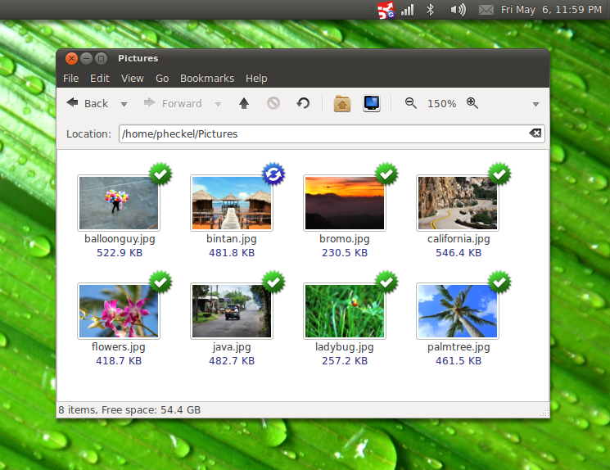

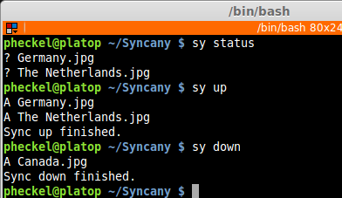
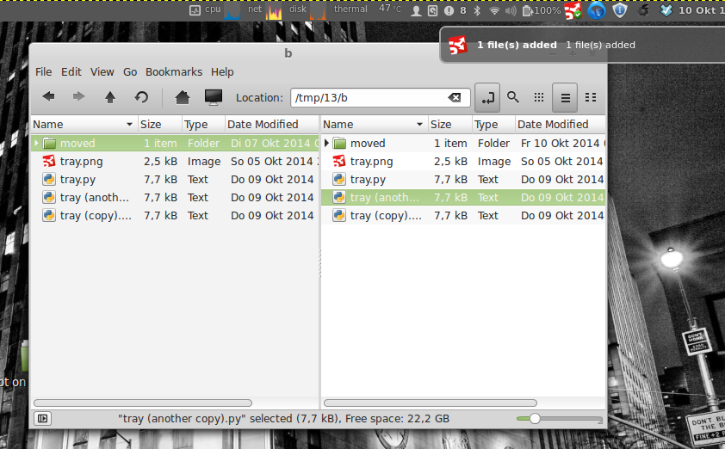
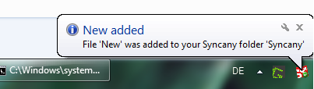
What is Syncany?
Syncany is an open source Dropbox-like file sync and backup tool. It synchronizes files and folders between computers either manually or automatically. Users can define certain folders on their machine and keep them in sync with friends or colleagues.
So what makes Syncany awesome? What makes it different?
Syncany is open-source software
Use-your-own storage (FTP, S3, WebDAV, ...)
Files are encrypted before upload (don’t trust anybody but yourself)
Files are deduplicated locally (space savings on remote storage)
Files are intelligently versioned (restoring old versions is easy)
Manual version control-like sync
Automatic Dropbox-like sync
Notes:
PROBLEM
Current file sync solutions do not care about user privacy. User data is stored in the cloud in plaintext.
Evil providers, government organizations or hackers might gain access to these files.
Sensitive data cannot be stored in the cloud. Privacy-aware personal users and businesses have no easy way to share files.
SOLUTION
A sync solution that encrypts data locally, before uploading to the cloud.
Sync your Files - Backup your photo collection and share files with friends.
Encrypted - Don't worry about your privacy. Files are encrypted before uploading.
Any Storage - Use any kind of storage - (S)FTP, WebDAV, and many more!

Slide 4
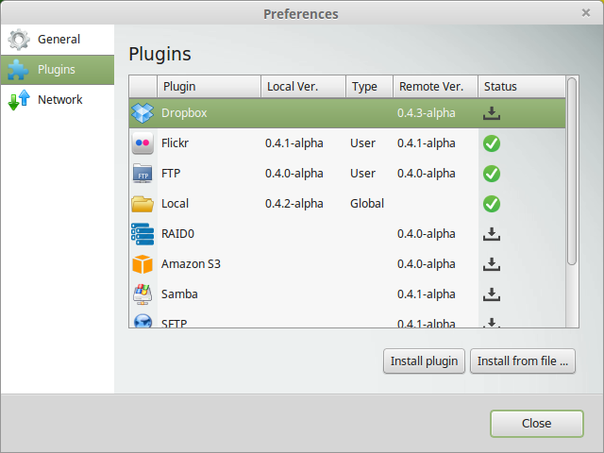
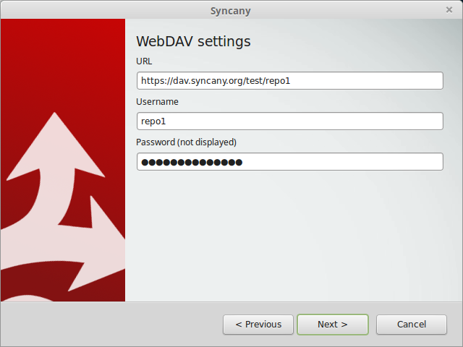
Storage Plugins
> Use-your-own storage, or even better: use any storage!
Storage plugins:
Amazon S3
Dropbox
Flickr
FTP
RAID0
Local (mounted drives; e.g. via FUSE)
OpenStack Swift
SFTP
Samba / CIFS
PHP / REST (3rd party, incubating)
WebDAV
(Easy to develop your own
in about 200-300 lines of code)
Other plugins:
Graphical User Interface
Simple Web Interface (PoC, looking for dev)
Notes:
PROBLEM
Current file sync solutions do not care about user privacy. User data is stored in the cloud in plaintext.
Evil providers, government organizations or hackers might gain access to these files.
Sensitive data cannot be stored in the cloud. Privacy-aware personal users and businesses have no easy way to share files.
SOLUTION
A sync solution that encrypts data locally, before uploading to the cloud.
Sync your Files - Backup your photo collection and share files with friends.
Encrypted - Don't worry about your privacy. Files are encrypted before uploading.
Any Storage - Use any kind of storage - (S)FTP, WebDAV, and many more!

Slide 5
Project History
First attempt: ~ What I learned: Never advertise a prototype!
Started in 2011, announcement of PoC on WebUpd8 (popular blog) and Ubuntu Podcast in May 2011
15,000 visitors in announcement week, 400 developers in mailing list, translated in 30 languages by excited helpers, >2,200 followers on Twitter; then big drop in interest due to non-functioning software.
Second attempt: ~ Doing it right: Make a stable core, then build on top of that!
Silent relaunch in October 2013 (no new announcement yet)
3-4 active developers, ~30 contributors, IRC channel with 25-30 people
When we announced the project (May 2011)
What we said: “This is a proof-of-concept, we need people to help”
What people heard: “This is production-ready secure Dropbox alternative”
First alpha release
(Mar 2014)
Planned first beta release
(in 2015)
Silent relaunch
(Oct 2013)
Last integrity-affecting
bug fixed (Dec 2014)
2012
2013
2014
2015
When people realized that it
is a prototype

Slide 6
Agenda
What is Syncany?
How does it work?
Focus Topics:
  Deduplication & Versioning
  Cryptography Concept
  Continuous Integration & Packaging

Slide 7
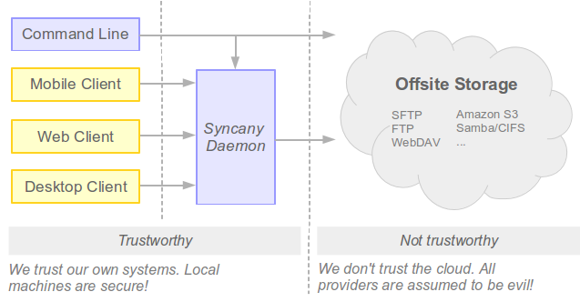
How does it work?
High Level Architecture
Components
Core library: Behavior logic (e.g. up/down operation), persistence, plugin architerture
Command line interface (CLI): $ sy <up|down|..>
Background daemon: REST/WS API for GUI/Web/Mobile interface
Plugins: Storage plugins & user interface plugins
Core Operations
CLI
Daemon/GUI
$ sy up
$ sy down
When local changes
occur & every 2min
When remote changes
occur & every 2 min
UpOperation ~ part of core library
Analyze
Index
Pack
Encrypt
Upload
DownOperation ~ part of core library
Analyze
Download
Decrypt
Unpack
Apply

Slide 8
Agenda
What is Syncany?
How does it work?
Focus Topics:
  Deduplication & Versioning
  Cryptography Concept
  Continuous Integration & Packaging

Slide 9
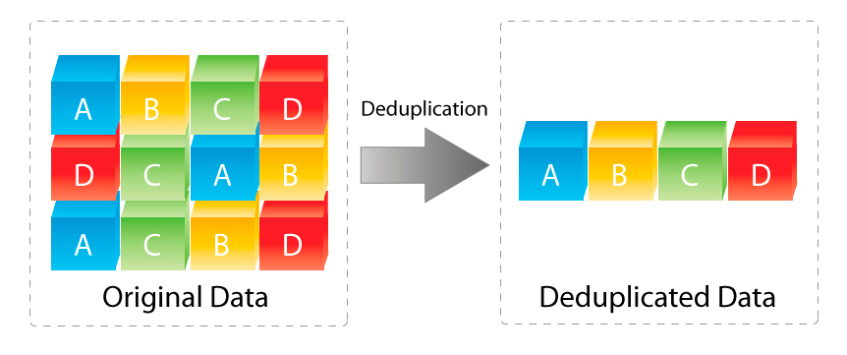
Deduplication & Versioning
> Syncany uses source-side, in-line, fixed-size deduplication
Data deduplication identifies duplicate sequences of bytes (chunks) and only stores one copy of that sequence.
If a chunk appears again in the same file (or in another file), deduplication only stores a reference to this chunk instead of its actual contents.
Distinction to compression
Not bound to location, date or time of files; stateful approach: local database/index necessary
Characteristics
Location: Target-side vs. Source-side
Time: In-line vs. Post-process
Chunking method: whole file vs. fixed-size vs. variable-size vs. format-aware chunking
Chunking methods
Methods have different impact on performance, I/O, CPU and RAM usage
Whole file chunking: Only deduplicate entire files, files are not split into chunks.
Fixed-size chunking: Files are split into chunks at fixed offsets, e.g. at 32 KB, 64 KB, 96 KB, …
Variable-size chunking: Files are split into chunks using “sliding window “-based chunking method (such as TTTD) and a fingerprinting method to determine the break points, e.g. using rolling checksum algorithms such as Adler-32 or Rabin.
...
Highlighted:
Concepts in Syncany
Details on
next slide

Slide 10
Deduplication & Versioning
> Syncany uses fixed-size chunking, but should use variable-size chunking
Fixed-Size Chunking
Variable-Size Chunking
5aaa
b2df
f612
81a4
71ad
ff7d
5aaab2
dff6
f61
281
a471a
dff7d
A:
A:
5aaa
a3df
f612
81a4
71ad
ff7d
5aaaa3
dff6
f61
281
a471a
dff7d
1 byte replacement, chunk boundaries remain
5 out of 6 chunks are duplicates
1 byte replacement, chunk boundaries remain
5 out of 6 chunks are duplicates
5aaab2
5aaab2
dff6
dff6
f61
f61
281a4
281
71ad
a471a
ff7d
5aaa
b2df
f612
81a4
71ad
ff7d
dff7d
B:
B:
15aaab2
1f5aaab2
bdff6
dff6
f61
f61
281a4
281
71ad
a471a
ff7d
1f5a
aab2
dfd6
1281
a471
adff
7d
dff7d
1 byte insertion, all chunk boundaries
shifted, no duplicates!
1 byte insertion, chunk boundaries remain
5 out of 6 chunks are duplicates
uses
Sliding window based rolling hash
Chunk break condition:
f mod D = 0
f is hash value
D is divisor
...
f
6
1
2
8
1
a
4
...
Hash (here: D = 0xff)
0x22 mod 0xff = 0
0xff mod 0xff = 0
0xf4 mod 0xff = 0
Legend:
f
6
1
2
8
5aaa
New chunk
6
1
2
8
1
5aaa
Duplicate chunk
1
2
8
1
a

Slide 11
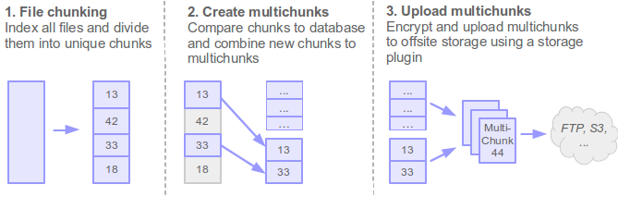
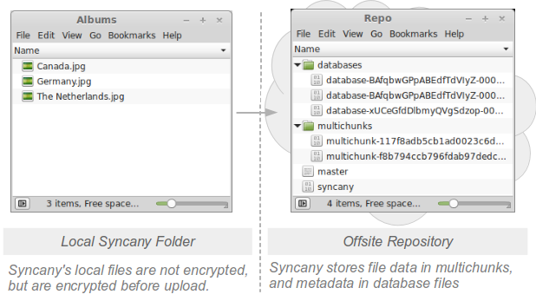
Deduplication & Versioning
> Syncany: Fixed-size, client-side dedup. with additional multichunking
Current implementation:
Fixed-size chunking, 512 KB chunks
4 MB multichunks
Also implemented, but not active:
Variable-size chunking with TTTD algorithm, via Adler-32 fingerprinting

Slide 12

Deduplication & Versioning
> Dedup. makes versioning easy, Syncany just keeps track of chunks
File 1a8a8dfeea4
Chunks
Presentation.ppt (version 1)
NEW
5aa..
b2d..
f61..
81a..
71a..
ff7..
+ 3.1 MB
Presentation.ppt (version 2)
CHANGED
5aa..
88a..
f61..
81a..
71a..
ff7..
+ 512 KB
Syncany.ppt (version 3)
MOVED
5aa..
88a..
f61..
81a..
71a..
ff7..
+/- 0 Bytes
Syncany.ppt (version 4)
DELETED
+/- 0 Bytes
File dfa818e192ad
Chunks
Products.ppt (version 1)
NEW
5aa..
b2d..
9ae..
e78..
aa1..
79e..
+ 2.1 MB
Free copies (copies of files add 0 byte to the repo)
Small file changes add minimal additional repo space
Restoring old/deleted files is easy

Slide 13
Agenda
What is Syncany?
How does it work?
Focus Topics:
  Deduplication & Versioning
  Cryptography Concept
  Continuous Integration & Packaging

Slide 14
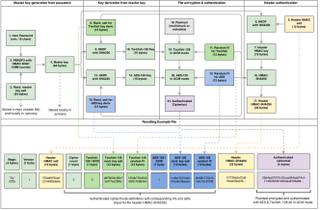
Cryptography Concept
> Assumptions and Algorithms
Security Assumptions
Storage provider and network infrastructure cannot be trusted
The local machine is secure
Users sharing a repository trust each other completely
Security Concepts
Pre-upload encryption
HTTPS-only daemon/server
Algorithms:
PBKDF2 with HMAC-SHA1, 1mm rounds, 512-bit salt
Password-Based Key Derivation Function 2, part of PKCS #5 v2.0
Applies SHA1 multiple times on the password and salt to derive a key from the password
Used in Syncany: per-repository master key generation
HKDF with SHA256, 96-bit salt
HMAC-based Extract-and-Expand Key Derivation Function (HKDF), RFC5869
Creates a derived key from the master key (input key material) and a salt
Used in Syncany: per-file key is derived from the master key
HMAC-SHA256, key derived with HKDF, 96-bit salt
Keyed-Hash Message Authentication Code (HMAC), RFC2104
Calculates a MAC using a cryptographic hash function (here: SHA256)
Used in Syncany: per-file header authentication
Twofish/AES 128-bit in GCM mode, key derived with HKDF, 96-bit salt
Symmetric encryption scheme, used in the Galois Counter Mode (GCM), an Authenticated Encryption with Associated Data (AEAD)
Used in Syncany: per-file encryption; AES and Twofish in nested
← Focus (details on next slide!)
SecretKeyFactory factory = SecretKeyFactory.getInstance("PBKDF2WithHmacSHA1");
KeySpec pbeKeySpec = new PBEKeySpec(password.toCharArray(), salt, 1000000, 512);
SecretKey masterKey = factory.generateSecret(pbeKeySpec);
HKDFBytesGenerator hkdf = new HKDFBytesGenerator(new SHA256Digest());
hkdf.init(new HKDFParameters(inputKeyMaterial, inputSalt, "Syncany..."));
byte[] derivedKey = new byte[outputKeySize / 8];
hkdf.generateBytes(derivedKey, 0, derivedKey.length);
headerHmac = Mac.getInstance("HmacSHA256", "BC");
headerHmac.init(hmacSecretKey); // via HKDF
headerHmac.update(headerBytes);
outputStream.write(headerHmac.doFinal());

Slide 15
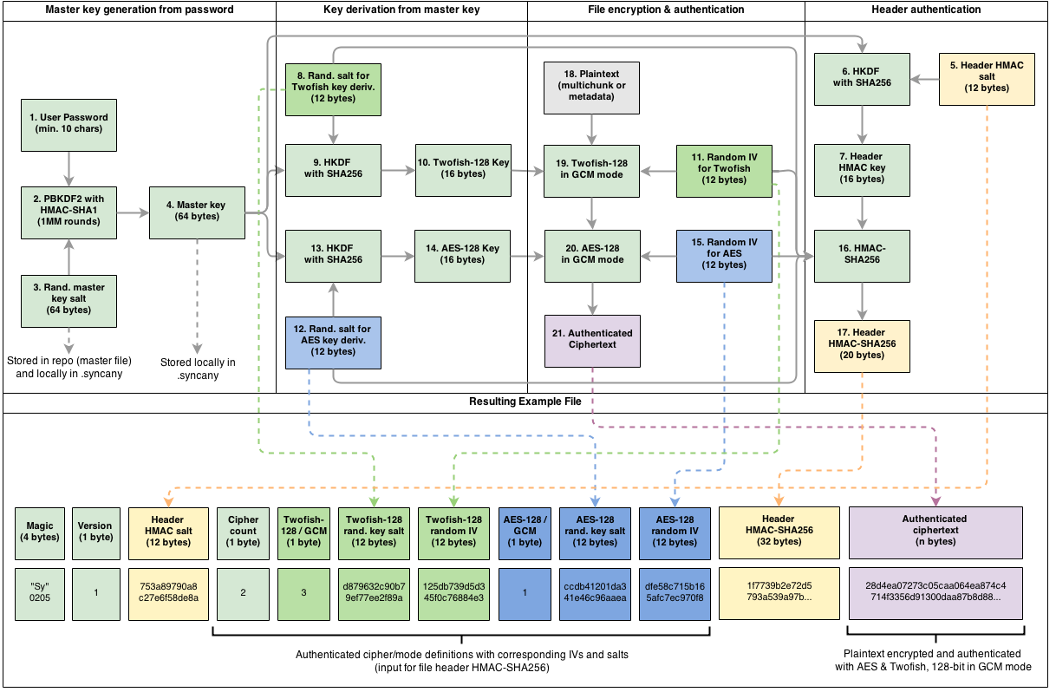
Cryptography Concept
> Encryption file format and used algorithms

Slide 16
Agenda
What is Syncany?
How does it work?
Focus Topics:
  Deduplication & Versioning
  Cryptography Concept
  Continuous Integration & Packaging

Slide 17
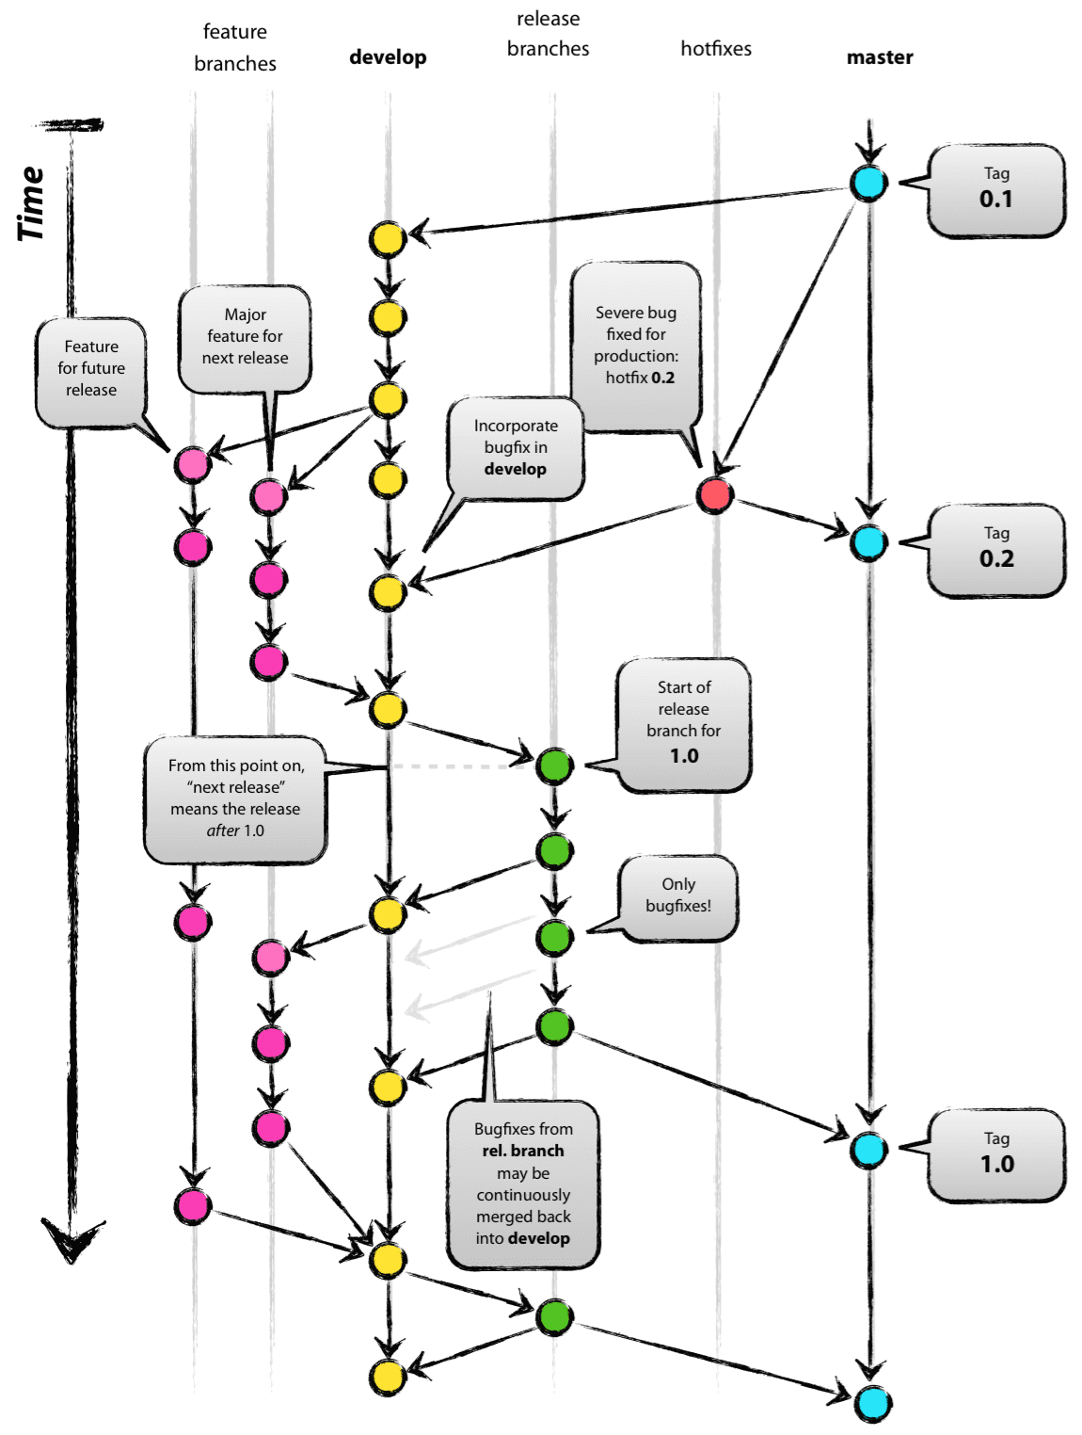
Continuous Integration & Packaging
> Commit to develop to create a snapshot, or to master for a release
Workflow components:
Git Branching Model (as per nvie.com)
Travis-CI (see travis-ci.org)
Branching model:
Development happens on the develop branch
The master branch is only used for releases, it is always production-ready
Releases on the master are tagged with vX.Y.Z (semver)
Branch naming:
  feature/ - Feature branches are prefixed (e.g. feature/issue333-history-browser)
  hotfix/ - Hotfix branches (e.g. feature/issue333-history-browser)
Travis CI
Reacts to every commit
Runs tests & builds packages, builds releases & snapshots

Slide 18






Continuous Integration & Packaging
> Things that happen when a developer runs “git push”
IRC
Consumer/
Initiator
Provider
2. Notify
via IRC
7. Notify
via IRC
7. Download Dockerfile
via HTTP GET
GitHub
3. Notify via
HTTP GET
Travis-CI
5. lftp mirror
via FTP
.deb/.exe/tar.gz
.zip/.app.zip
Syncany Server
6. Notify via
HTTP GET
Docker
4. git clone
8. Download .deb
via HTTP GET
If master branch:
RELEASE
If develop branch:
SNAPSHOT
get.syncany.org
archive.syncany.org
api.syncany.org
docs.syncany.org
reports.syncany.org
9.
Download .deb, .exe
.app.zip, .tar.gz or .zip
11.
Install plugins
$ sy plugin install ...
13.
Browse unit test
& coverage results
1. git push
10.
On Debian:
$ apt-get install syncany
12.
Browse User Guide
& JavaDoc
14.
docker pull ...
docker run -ti ...
Developer
User

Slide 19
Continuous Integration & Packaging
> Debian/Windows/OSX packaging
All of the following steps are done with every commit to the develop or master branch. The result is either a snapshot or a new release.
Debian packaging & APT archive
Travis: Automatic .deb-file packaging using debuild, and FTP upload to Syncany server
Syncany server: Add to release/snapshot APT archive via reprepro
Users: Download/update Syncany & plugins via apt-get install
Windows packaging
Travis: Automatic creation of Inno Setup Windows installer (.exe), and FTP upload to Syncany server. Speciality: The Inno Setup compiler is run inside Wine on Linux.
Syncany server: Place in release/snapshot download folder; Users: Download via website
OSX packaging
Travis: Automatic creation of .app.zip-file
Syncany server: Place in release/snapshot download folder; Users: Download via website
Other packages:
Arch Linux PKGBUILD
OSX homebrew recipe
Docker image
.zip and .tar.gz archives

Slide 20
Links & Resources
Website - https://www.syncany.org/
User Guide - https://www.syncany.org/r/guide
Code & Issues - https://github.com/syncany/syncany
Wiki - https://github.com/syncany/syncany/wiki
IRC - #syncany on Freenode - https://webchat.freenode.net/?channels=syncany
(active, 20-30 people hang around here; 5-6 actually talk, my nick is “binwiederhier”)
Videos on YouTube - https://www.youtube.com/channel/UCzegH3dpTK5HHQx6jJ5yhdQ
Videos on Asciinema - https://asciinema.org/~binwiederhier

Slide 21
Backup

Slide 22
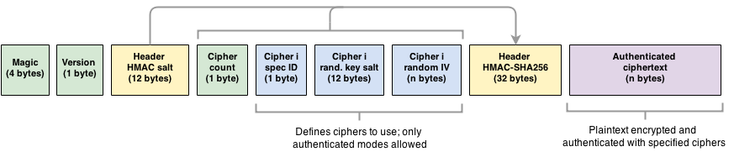
Cryptography Concept
> Generic File Structure

Slide 23
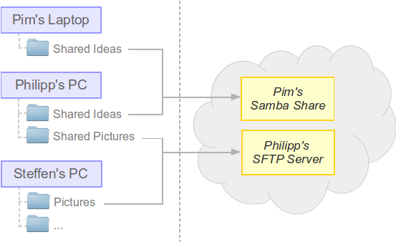
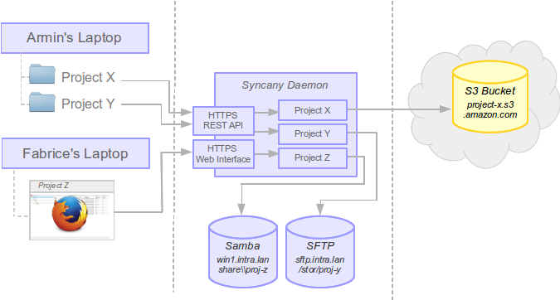
Use Cases
Use Case 1: Friends sharing files
Use Case 2: Sharing in a company

Slide 24
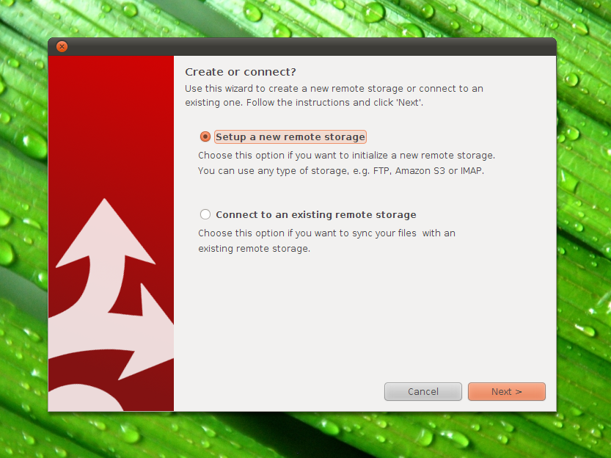
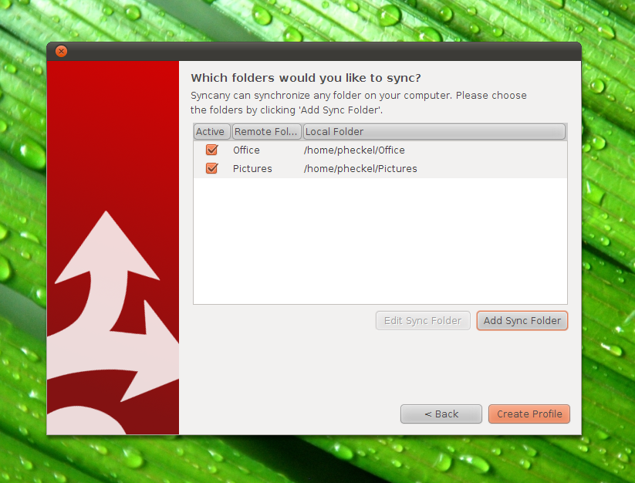

Syncany Desktop User Interface
> Wizard Style Setup
Cross-Platform Desktop Demo
https://www.youtube.com/watch?v=eHoA5_8gRBc

Slide 25
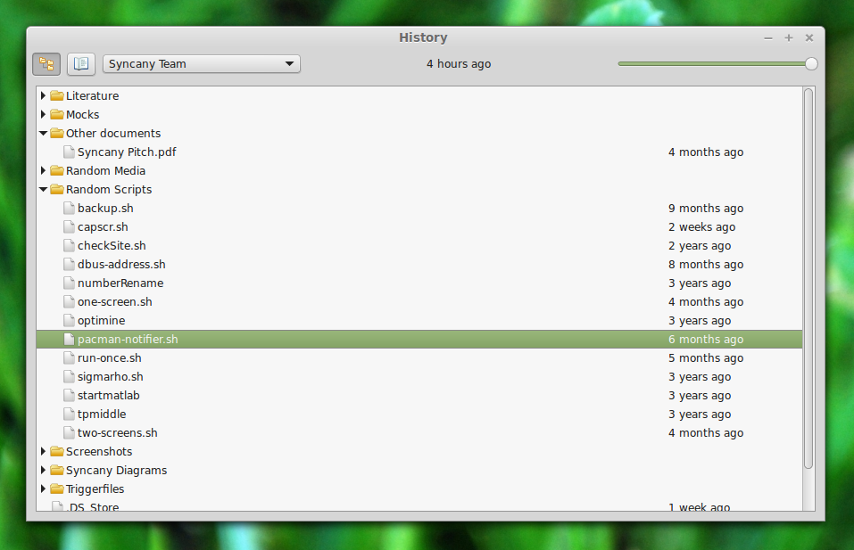
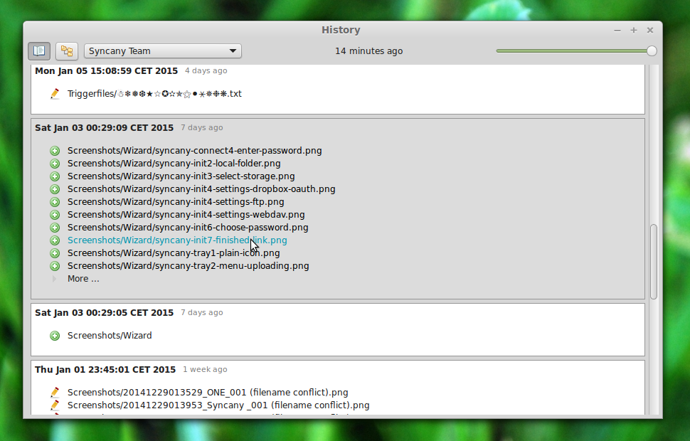
Syncany Desktop User Interface
> History browser: Browse and restore old file versions

Slide 26
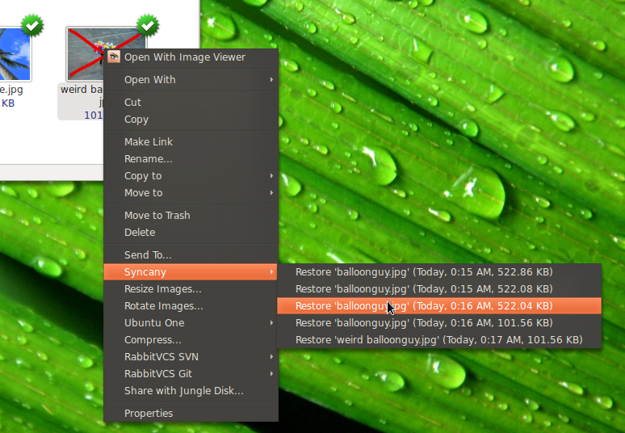
Syncany Desktop User Interface
> File Manager Integration (2011-version PoC, looking for devs)
Cross-Platform Desktop Demo
https://www.youtube.com/watch?v=eHoA5_8gRBc

Slide 27
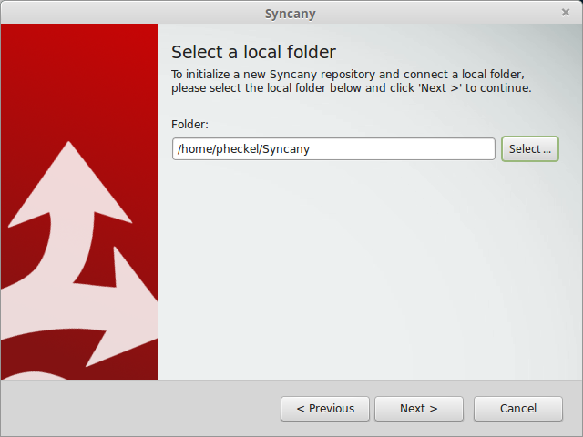
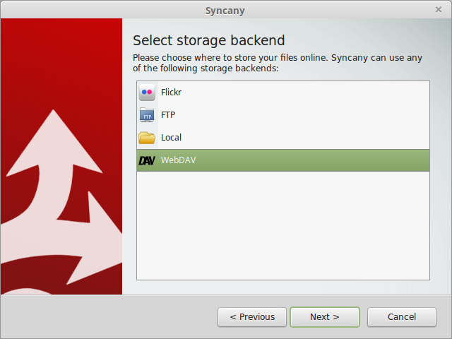
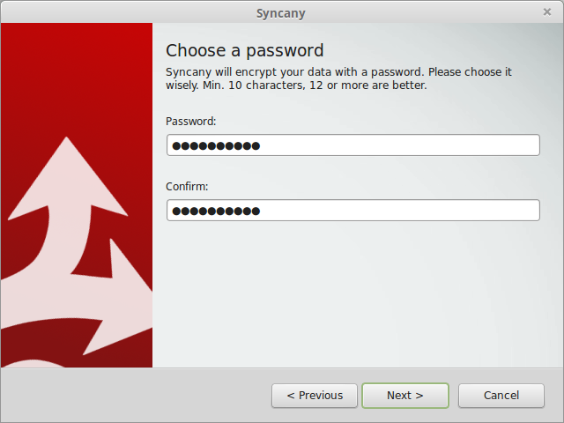
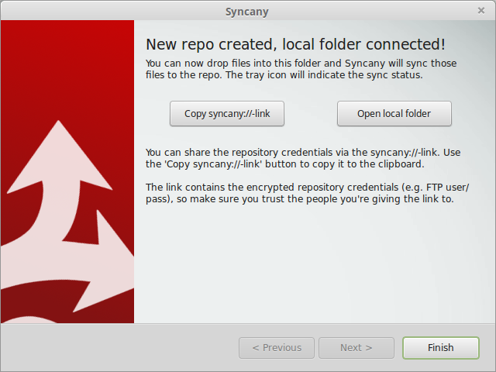
Using Syncany
> Example: Syncing a local folder to a new WebDAV-based repository
1. Choose the folder you want to sync
2. Choose a storage backend
3. Enter storage backend credentials
4. Choose password (used for encrypt.)
5. Done. Share a syncany://-link if you want.
Notes:
PROBLEM
Current file sync solutions do not care about user privacy. User data is stored in the cloud in plaintext.
Evil providers, government organizations or hackers might gain access to these files.
Sensitive data cannot be stored in the cloud. Privacy-aware personal users and businesses have no easy way to share files.
SOLUTION
A sync solution that encrypts data locally, before uploading to the cloud.
Sync your Files - Backup your photo collection and share files with friends.
Encrypted - Don't worry about your privacy. Files are encrypted before uploading.
Any Storage - Use any kind of storage - (S)FTP, WebDAV, and many more!

Slide 28
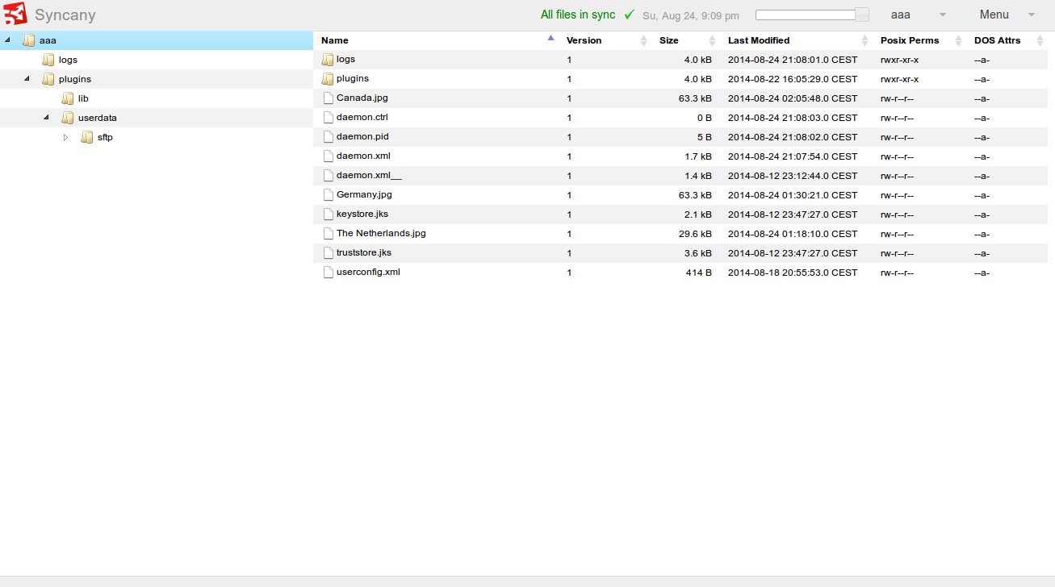
Syncany Web Interface
> Web-based File Manager (proof-of-concept; looking for devs)
Web Interface Demo
https://www.youtube.com/watch?v=2NPVffywZVs

